Slide 1
Predicting Airbnb Prices Using XGboost & Conformal Prediction
Presenters: Younghoon Kim

Slide 2
Traditional ML Models
Weaknesses of Conventional ML Models
Simplifying Complex Patterns: Where Conventional ML Falls Short
Understanding the Challenge:
Traditional machine learning sometimes fails to capture the subtleties in data. This becomes clear when two almost identical properties have large price differences, and the model cannot tell why.
A Real-World Example:
Imagine two similar homes in the same city: one is $50 per night, and the other is $200. Why the gap? Conventional models may miss the hidden details that explain it, potentially leading to less accurate price predictions and lost income for property owners.
Boosting as a Solution
Boosting: Sharpening Predictions in ML
Advantages of Boosting:
Boosting tackles these challenges head-on. It's like a self-improving cycle; each round of predictions learns from the last, especially those tricky cases that standard models get wrong.

Slide 3
Introduction to ML& Information Loss in Boosting
The Case of Information Loss in Boosting
Understanding the Problem:
While boosting improves model accuracy, it can sometimes lead to significant information loss.
This information loss typically occurs as the model increasingly focuses on correcting misclassified instances, potentially neglecting broader data trends.
Impact on Predictive Accuracy:
Information loss can compromise the generalizability of the model, making it less effective on new, unseen data.
Boosting’s iterative refinement often sacrifices simplicity and prediction certainty to new data in pursuit of lower error rates on the training set.
Conformal prediction bridges this gap by quantifying the uncertainty associated with each prediction.

Slide 4
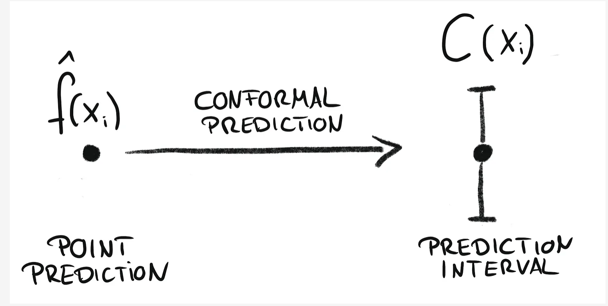
What is Conformal Prediction?
What is Conformal Prediction?
Conformal prediction is a statistical framework used to assess the reliability of machine learning predictions by providing guaranteed confidence levels for each prediction.
Key Features:
Works with any underlying predictive model."
It provides a way to measure the certainty of predictions, ensuring they are trustworthy.

Slide 5
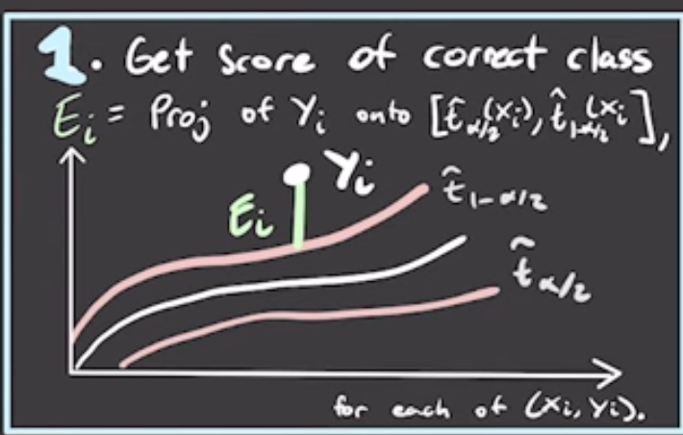
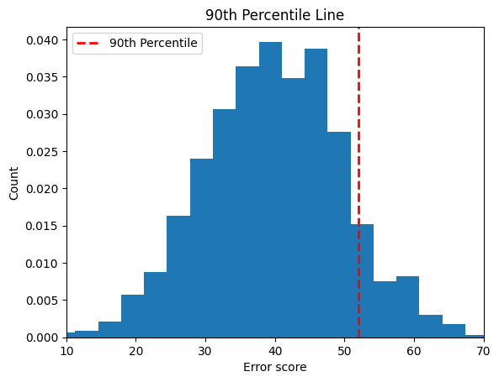
Basic Concepts of Conformal Prediction
How Conformal Prediction Operates:
Assessing New Data (Calibration):
Conformal prediction examines past errors to estimate how typical or atypical a new piece of data is.
Prediction Intervals:
Creating Certainty Ranges:
It sets up ranges that are expected to include the true answer with a certain level of trust, such as 90~ 95%.
Importance in Machine Learning:
This method measures the confidence in a prediction, which is especially valuable when making critical decisions based on the model's output.

Slide 6
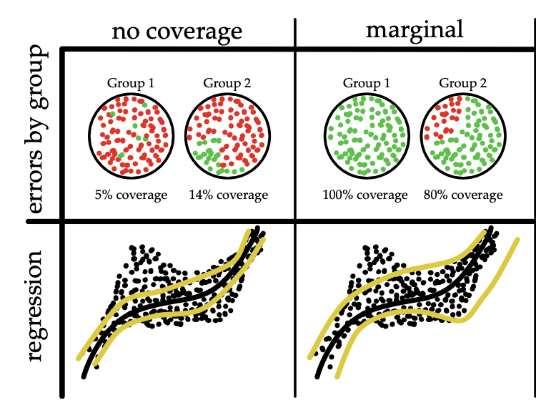
The Concept of Marginal Coverage
Definition of Marginal Coverage:
Marginal coverage refers to the proportion of times the conformal prediction region contains the true outcome, averaged over all possible future observations."
Limitations:
Uniformity: Assumes all predictions should adhere to the same level of confidence.
Weakness: It might be too broad or too conservative, lacking specificity for individual instances or categories.

Slide 7
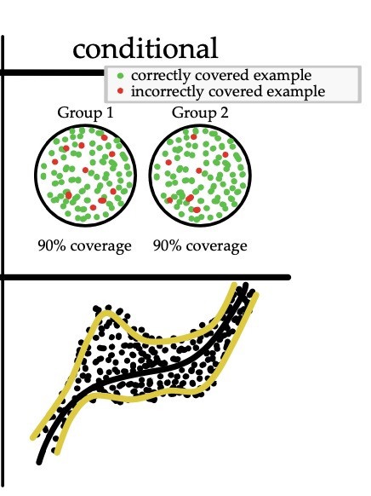
Conditional Coverage with Categorical Variables
Conditional Coverage:
Conditional coverage tailors the prediction intervals to specific categories or conditions, improving relevance and precision.
Why It's Better:
Context-sensitive: Adjusts prediction intervals based on the categorical variables, providing more tailored and accurate intervals.
Improved Accuracy: Results in more precise and reliable predictions for specific groups or conditions.

Slide 8
Marginal vs. Conditional Coverage
Key Differences:
Marginal coverage provides one-size-fits-all intervals, potentially over-conservative and less informative."
Conditional coverage offers context-specific intervals, which are more informative and practical for decision-making."
Practical Implications:
In areas like personalized medicine or targeted marketing, conditional coverage's tailored approach ensures that predictions are more relevant and actionable."
Conclusion:
While marginal coverage is simpler and provides a broad safety net, conditional coverage offers the precision needed in fields where the stakes and variability are high.

Slide 9
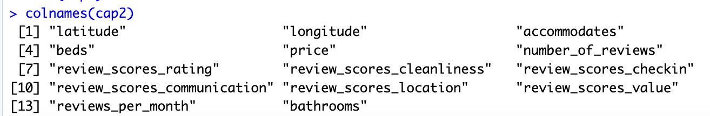
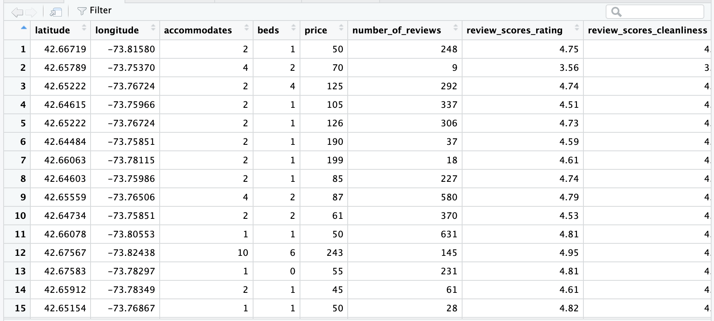
DATA

Slide 10
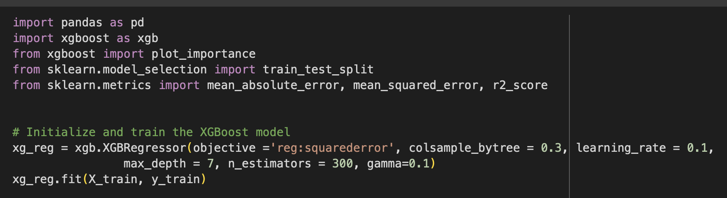
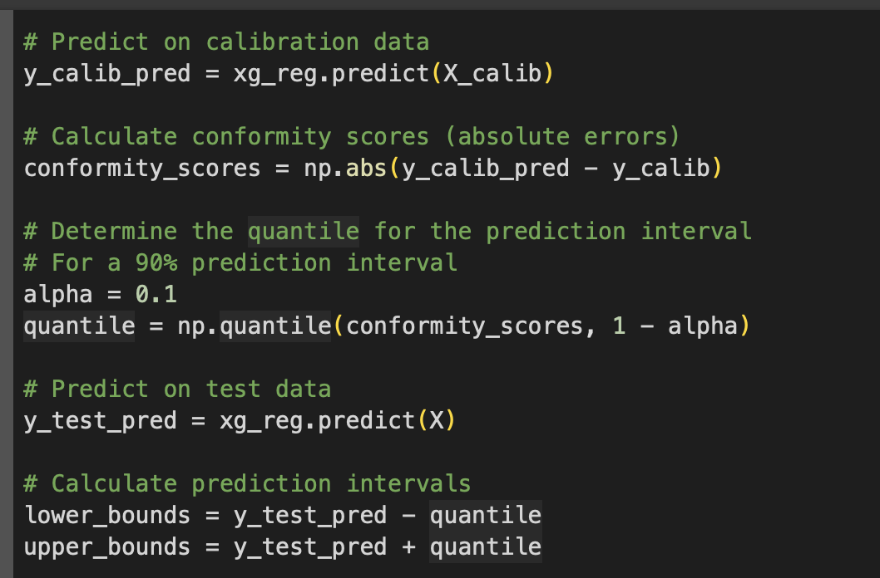
GXBoost with Marginal Coverage

Slide 11
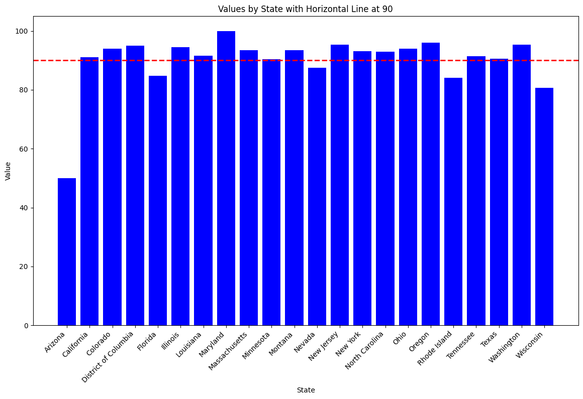
Result

Slide 12
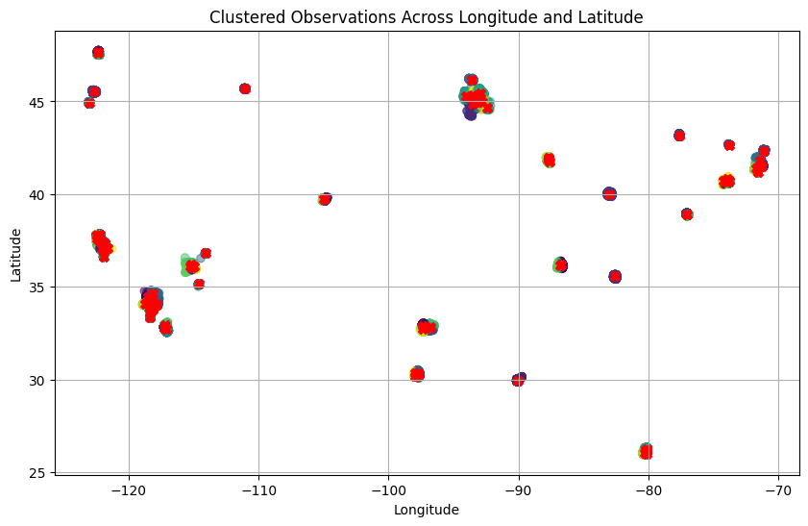
Generate groups by KNN

Slide 13
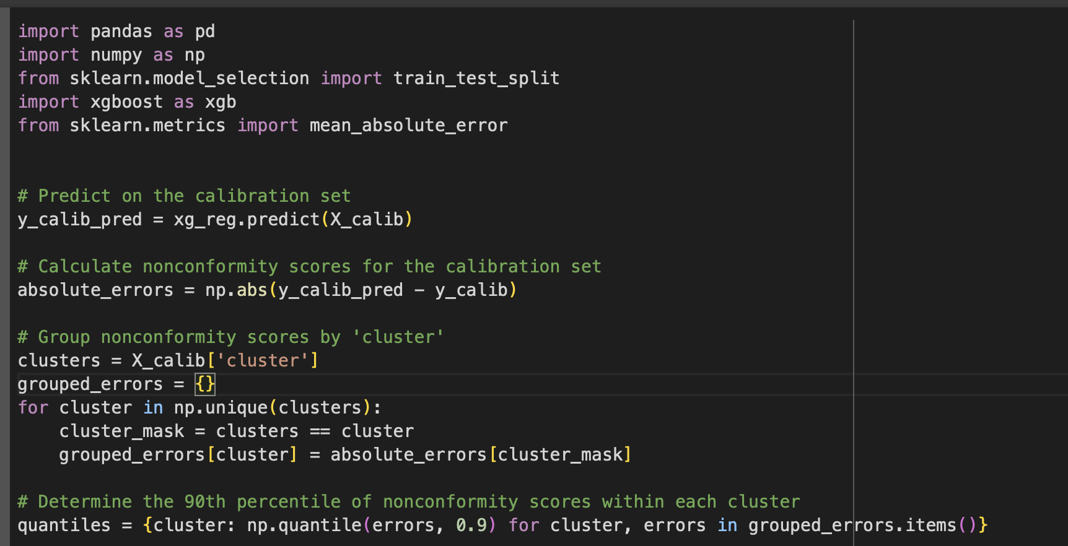
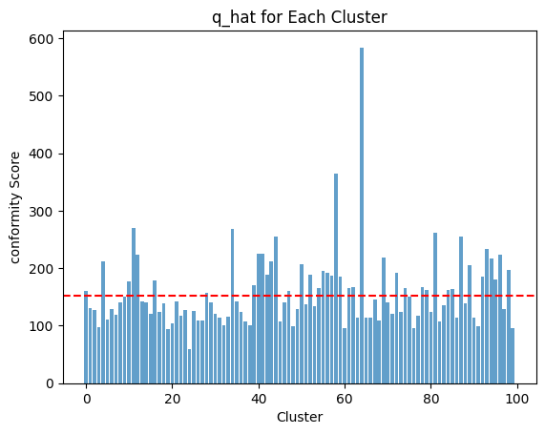
XGBoost with Conditional Coverge

Slide 14
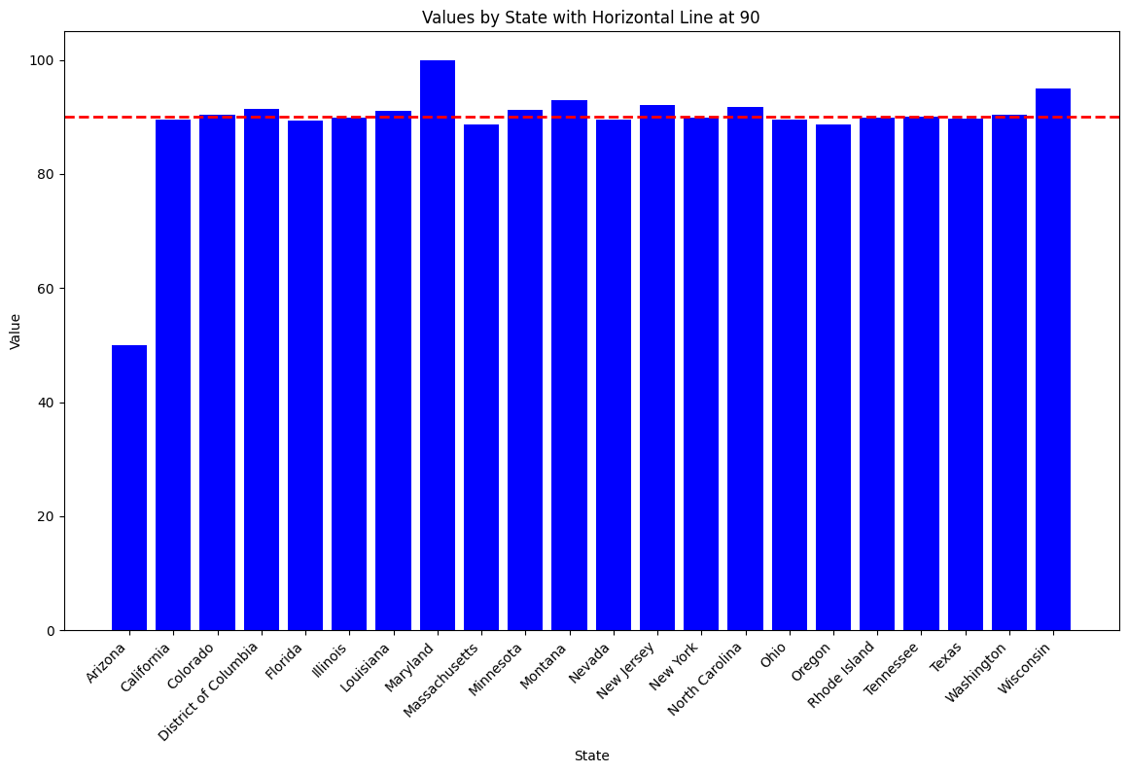
Result

Slide 15
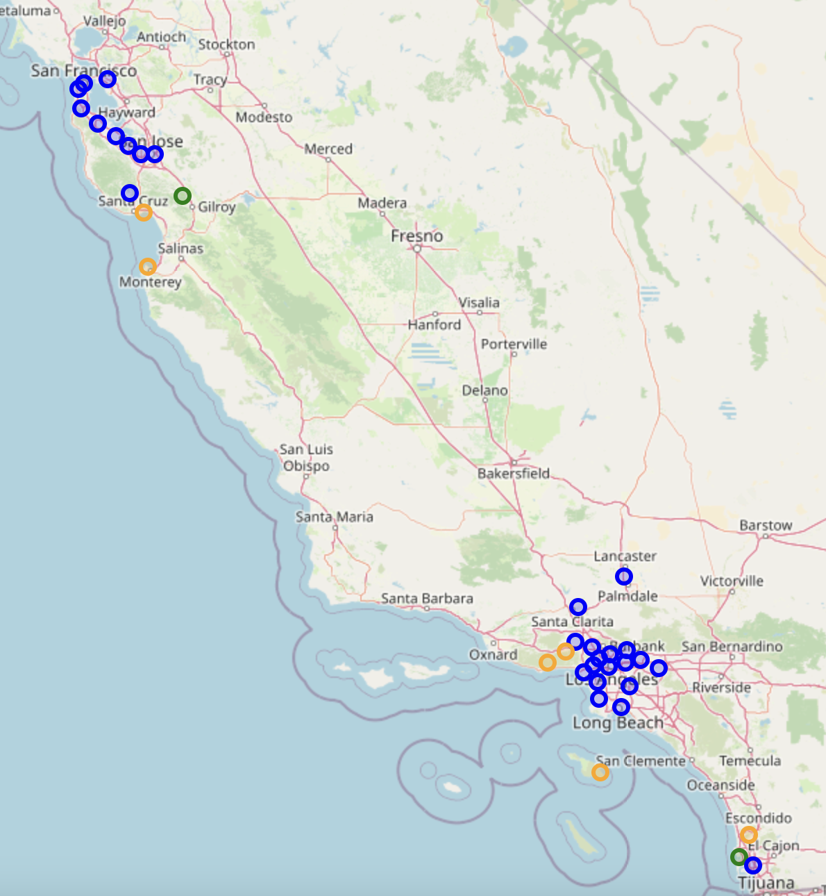
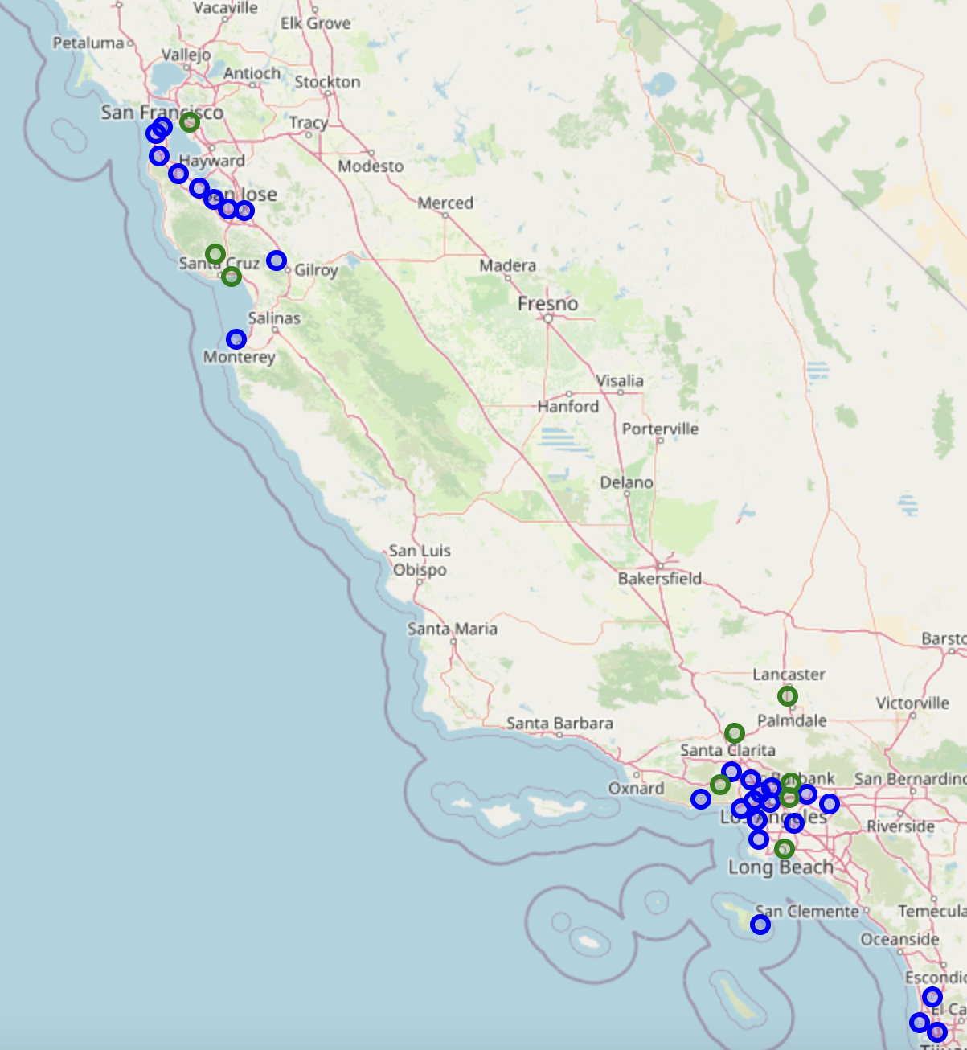
Marginal Cover
BLUE == Good Coverage
Green == Close to Coverage
Orange == Out
Conditional Coverage
BLUE == Good Coverage
Green == Close to Coverage
Orange == Out

Slide 16

End of Presentation
Thank you for Watching

